Slide 1
2014
Crop Insurance
Review

Slide 2
Risk Management
It is your responsibility
Let us help you

Slide 3


Slide 4
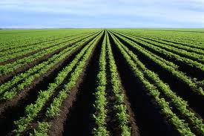
Why Should I Carry
Crop Insurance On My Crops?
The only guarantee of any income when you plant or are prevented
from planting your crops
Required by Farm Service Agency (FSA) for participation in Crop
Disaster Program (CDP)
Takes the place of shrinking government programs
Allows you to forward contract more of your crop
Can be used as collateral
  Financial institutions requiring crop insurance
Keeps your plans on track
Less expensive than debt
  Government pays up to 60% of your premium
    on average
Provides peace of mind
Tax deductible

Slide 5
Causes For Crop Loss

Slide 6
Crop Insurance Summary
Virginia
Year | Total Premium | Subsidy/ Cost Share | Farmer Premium | Pay Out | Loss Ratio
2012 | $69,323,127 | $45,135,436 | $24,187,691 | $51,723,306 | 2.14
2011 | $74,816,306 | $48,474,267 | $26,342,039 | $39,134,263 | 1.49
2010 | $47,013,683 | $29,764,051 | $17,249,632 | $118,864,477 | 6.90
2009 | $49,855,016 | $31,096,719 | $18,758,297 | $27,706,302 | 1.48
2008 | $56,707,834 | $34,059,624 | $22,648,210 | $54,496,433 | 2.41
2007 | $37,333,654 | $22,465,282 | $14,868,372 | $62,667,180 | 4.21
2006 | $26,423,574 | $15,878,706 | $10,544,868 | $16,992,717 | 1.61
2005 | $23,394,289 | $14,280,578 | $9,113,711 | $16,117,507 | 1.77
2004 | $28,218,521 | $17,036,165 | $11,182,356 | $15,160,121 | 1.36
2003 | $23,180,823 | $14,122,343 | $9,058,480 | $37,681,262 | 4.16

Slide 7
Summary of Total Policies Sold for 2010
(By Level)
16.62% 0.86% 4.33% 23.33% 26.01% 19.31% 6.83% 2.71%
Coverage Level

Slide 8
Summary of Total Policies Sold for 2010
(By Plan)

Slide 9
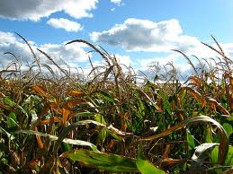
What Are Some Added Features
To My Policy?
Quality adjustment
Yield protectors
  10% Cup
  Yield Floor
    80% of T-Yield (Max) 5 or more years
  60% T-Yield Option
Replant payments
Prevented Plant payments
Late Plant option

Slide 10
Prevented Plant
Prevented Plant (PP) – failure to plant the insured crop by the final planting date or within the late planting period. You must have been prevented from planting the insured crop due to an insured cause of loss that is general in the surrounding area and that prevents other producers from planting acreage with similar characteristics.
20/20 Rule
  Minimum 20 acres or 20% of a unit
60% of timely planted acreage guarantee (grain crops)
  Can buy-up
Timely notice
  Must be submitted to us within 72 hours of final plant date or 72 hours of late plant date (note: dates vary by county)
    Or date you stop planting
If you plant the acreage after reporting as PP, you need to notify us
  At that time, you may elect to retain PP coverage or not insure

Slide 11
Replant Provisions
  Available for most Spring Crops
  20/20 rule
    Minimum 20 acres or 20% of the unit
  Payment rates
    Soybeans (3 bu.)
    Corn (8 bu.)
    Grain Sorghum (7 bu.)
    Corn Silage (1 ton)
  Submit Timely Notice of Loss
  Self Certification for 50 acres or less
  Adjuster must contact you BEFORE you replant
    NLS Team will be first contact
      Do not report that crop has been replanted
      If self certification form is used, make sure that replant date is not before notice of loss date

Slide 12
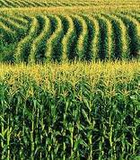
How Will My Unit Structure
Be Determined?
Basic Unit
  All farms in a county with 100% interest
    10% average discount
Optional unit
  Production kept separate by FSN
Enterprise unit
  All farms in a county with 100% interest
    Up to 60% discount

Slide 13
Enterprise Unit Definition
  20/20 rule
    A minimum of 20 acres or 20% of the unit planted, whichever is the lesser, on at least two FSN’s or an aggregate (multiple) of farms
  Unit Definition - Total of all acres planted to a particular crop in a county
  660 acres on a single FSN

Slide 14

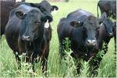
What Crop Insurance Plans Are Available?
Grain/Cotton
  YP
    Production guarantee
      Bushels/Pounds at a set price
  RP
    Revenue Product
      $ $ $ Guarantee
Tobacco, Peanuts, Tomatoes
  APH
    Production guarantee
      Production at a set price
Livestock Risk Protection
  $$$ Guarantee
Pasture, Rangeland, Forage
  $$$ Guarantee

Slide 15
RP Soybean Prices 2003-2012
March 15 Sales Closing Date

Slide 16
How Much Indemnity Payment Will I Receive If
Harvest Price Is Lower Than Base Price?
Soybeans - 1 Acres 50 Bushel APH
 | 70 | 70
 | APH | RP
Base Price | $13.36 | $13.36
Harvest Price |  | $9.22
Guarantee Per Acre | 35.0 | 35.0
Coverage Per Acre | $468 | $468
Cost Per Acre | $27 | $40
Rate Per Hundred | .057 | .085
Loss % Harvested Prod/Acre
36% 32.0 bu | $40 | $173
55% 22.5 bu | $167 | $260
60% 20.0 bu | $200 | $283
65% 17.5 bu | $234 | 306
70% 15.0 bu | $294 | $329
75% 12.5 bu | $301 | $352
80% 10.0 bu | $334 | $375
85% 7.5 bu | $367 | $398
90% 5.0 bu | $401 | $422
95% 2.5 bu | $434 | $445
100 % 0.0 bu | $468 | $468

Slide 17
How Much Indemnity Payment Will I Receive If
Harvest Price Is Higher Than Base Price?
Soybeans - 1 Acre 50 Bushel APH
 | 70 | 70
 | APH | RP
Base Price | $9.23 | $9.23
Harvest Price |  | $11.63
Guarantee Per Acre | 35.0 | 35.0
Coverage Per Acre | $323 | $407
Cost Per Acre | $21 | $27
Rate Per Hundred | .064 | .066
Loss% Harvested Prod/Acre
36% 32.0 bu | $28 | $35
55% 22.5 bu | $115 | $145
60% 20.0 bu | $138 | $174
65% 17.5 bu | $162 | $204
70% 15.0 bu | $185 | $233
75% 12.5 bu | $208 | $262
80% 10.0 bu | $231 | $291
85% 7.5 bu | $254 | $320
90% 5.0 bu | $277 | $349
95% 2.5 bu | $300 | $378
100% 0.0 bu | $323 | $407

Slide 18
Double Crop Verification
In order to qualify for two 100% payments in a crop year on the same land you must have acceptable records of double cropping history.
Number of eligible acres will be 2nd highest year of the last four in which the first crop was planted.
Steps to Achieve
Report acreage to FSA.
  FSA will code as Double Crop. (DC)
Report to us using 578 Producer Print. (PP)
  Single and Double Crop acres will be distinguished.
Schedule of Insurance
    Second Crop flag to be used for SC acres
Obtain settlement sheet from buyer and retain.

Slide 19
You must keep your 1st crop and 2nd crop production separate by field if a loss occurs on the 1st crop AND you have not met double crop requirements.
100 Acres Wheat/$10,000 Liability
60 | 40
No Loss | 100% Loss= $4,000 - $1,400 (35% payment) $2,600 (balance to restore)
100 Acres Soybeans/$10,000 Liability
60 | 40
Loss= $5,000 | Loss=$1,000
Payment keeping production separate:
$1,400
+ $2,600
+ $5,000
$ 9,000
Payment NOT keeping production separate:
$1,400
+$6,000
$7,400

Slide 20
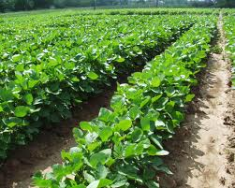
RP – Soybeans
February 28 Sales Closing (NC, SC)
Base Price = The January 15 – February 14 average daily CBOT settlement price for January soybeans.
Harvest Price = The November 1 – November 31 average daily CBOT settlement price for January soybeans. (RP limits the price move to 200% up and none down.)
Your final revenue guarantee will never drop below the base price, but it may rise above it, unless you exclude the FH option (RP).

Slide 21
RP – Soybeans
March 15 Sales Closing (VA, WV)
Base Price = The February average daily CBOT settlement price for January soybeans.
Harvest Price = The November average daily CBOT settlement price for January soybeans. (limits the price move to 200% up and none down.)
Your final revenue guarantee will never drop below the base price, but it may rise above it, unless you exclude the FH option (RP).

Slide 22
RP – Soybeans
March 15 Sales Closing (OH, TN)
Base Price = The February average daily CBOT settlement price for November soybeans.
Harvest Price = The October average daily CBOT settlement price for November soybeans. (limits the price move to 200% up and none down.)
Your final revenue guarantee will never drop below the base price, but it may rise above it, unless you exclude the FH option (RP).

Slide 23
RP Corn Prices 2003-2012
March 15 Sales Closing Date

Slide 24

RP – Corn
February 28 Sales Closing (NC)
Base Price = The January 15 – February 14 average daily CBOT settlement price for December corn.
Harvest Price = The September average daily CBOT settlement price for December corn. (RP limits the price move to 200% up and none down)
Your final revenue guarantee will never drop below the base price, but it may rise above it, unless you exclude the FH option (RP).

Slide 25
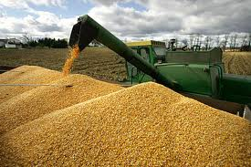
RP – Corn
February 28 Sales Closing (SC)
Base Price = The January 15 – February 14 average daily CBOT settlement price for September corn.
Harvest Price = The August average daily CBOT settlement price for September corn. (RP limits the price move to 200% up and none down)
Your final revenue guarantee will never drop below the base price, but it may rise above it, unless you exclude the FH option (RP).

Slide 26
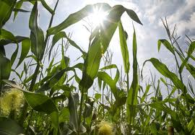
RP – Corn
March 15 Sales Closing (OH, TN, VA, WV)
Base Price = The February average daily CBOT settlement price for December corn.
Harvest Price = The October average daily CBOT settlement price for December corn. (RP limits the price move to 200% up and none down)
Your final revenue guarantee will never drop below the base price, but it may rise above it, unless you exclude the FH option (RP).

Slide 27
RP Wheat Prices 2003 -2012
September 30 Sales Closing Date

Slide 28
RP – Wheat
September 30 Sales Closing
(NC, SC, TN)
Base Price = The August 15 – September 14 average daily CBOT settlement price for July wheat.
Harvest Price = The June 1 – June 30 average daily CBOT settlement price for July wheat. (RP limits the price move to 200% up and none down)
Your final revenue guarantee will never drop below the base price, but it may rise above it, unless you exclude the FH option (RP).

Slide 29
RP – Wheat
September 30 Sales Closing
(OH, VA, WV)
Base Price = The August 15 – September 14 average daily CBOT settlement price for July wheat.
Harvest Price = The July1 – July 30 average daily CBOT settlement price for September wheat. (RP limits the price move to 200% up and none down)
Your final revenue guarantee will never drop below the base price, but it may rise above it, unless you exclude the FH option (RP).

Slide 30
RP Cotton Prices 2003-2012
February 28 Sales Closing Date

Slide 31
RP – Cotton
February 28 Sales Closing
(NC,SC)
Base Price = The January 15 – February 14 average daily ICE settlement price for December Cotton.
Harvest Price = The October 1 – October 31 average daily ICE settlement price for December Cotton. (RP limits the price move to 200% up and none down)
Your final revenue guarantee will never drop below the base price, but it may rise above it, unless you exclude the FH option (RP).

Slide 32
Importance of Records
In order to use your actual yields you must report at least four years of continuous records. For optional units you must report most recent year production by FSN.
Crop – Wheat T-Yield – 40 Bushels
 | No Records | 1 Year Records | 2 Year Records | 3 Year Records | 4 Year Records
 | 65% | 80% | 90% | 100%
APH | 26 | 32 | 36 | 40 | 50
 | 26 | 32 | 36 | 50 | 50
 | 26 | 32 | 50 | 50 | 50
 | 26 | 50 | 50 | 50 | 50
Total | 104 | 146 | 172 | 190 | 200
 | / 4 | -------- | -------- | -------- | /4
APH | 26 Bushels | 37 Bushels | 43 Bushels | 48 Bushels | 50 Bushels
Level | .65 | --------- | -------- | --------- | .65
Guarantee | 17 Bushels | 24 Bushels | 28 Bushels | 31 Bushels | 33 Bushels
Price | $8.20 | --------------- | ---------------- | ---------------- | $8.20
Coverage | $139 | $198 | $230 | $256 | $267
Premium | $12.75 | $10.52 | $9.92 | $9.64 | $9.56

Slide 33
Tobacco
Crop Insurance
2014

Slide 34
Tobacco
Crop Rotation Rule has been removed
Quality Adjustment
  Modified for least valuable grades
  Must have tobacco graded by a USDA grader through Tobacco Administrative Grading Service (TAGS)
    (855)776-8570
    www.tobaccograding.com
  Cost is approximately .02/lb.
Stalk/Stubble Inspections
  Must be made if you have a loss or anticipate a loss
  Claim will be denied if stalks/stubbles are destroyed before inspection is made
  If uncertain of loss, leave stalks/stubbles in place
Growing Season Inspections (GSI)
  Trigger - 3 losses within the last 5 years
    Inconsistent yields
  Appraisals may be used to determine production to count

Slide 35
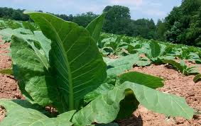
How Will My Unit Structure Be Determined?
Basic
  All tobacco under one FSN regardless of share arrangement
Enterprise (NC only)
  One unit in a county
  Discount
    2-3 FSN’s = 10% Discount
    4-6 FSN’s = 15% Discount
    7+ FSN’s = 20% Discount

Slide 36
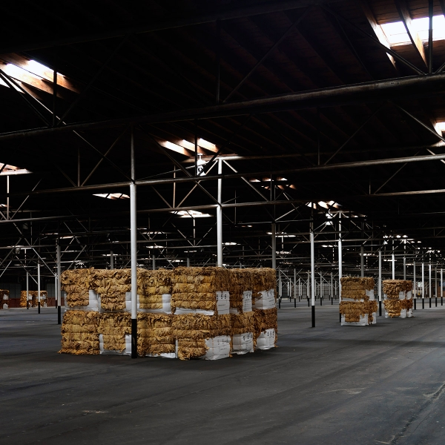
What Are Acceptable Production Records?
Basic Units
  Market receipts – Settlement Sheet Required in event of a loss
    FSN or Farm Name as stated on Schedule of Insurance is to be marked by each bale
Note: A bale can be split if backed by Farm Management records

Slide 37
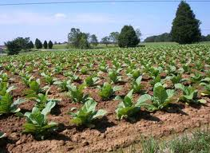
My Contractor Will Only Issue One Contract For 100% Share. Can I Still Have Separate Units By FSN Or Share Arrangements? YES
Keep production separate by FSN and share
  FSN or Farm Name as stated on Schedule of Insurance is to be marked by each bale
Shares with Various Entities
  Paper trail which shows $ $ distribution and matches:
    Crop Insurance Records
    FSA Records

Slide 38
How Will My Flue Guarantee Be Calculated?
Flue Tobacco Unit: 001-01-00 Shareholder: | Crop Year: 2012 FSN: 1000 Farm Name: Davis Tran Yield: 2301
Year Production Acres Yield 2002 0 0 0 2003 0 0 0 2004 0 0 0 2005 0 0 0 2006 0 0 0 2007 0 0 0 2008 3000 1.0 3000 A 2009 0 1.0 1380 YA 2010 0 1.0 1380 YA 2011 0 1.0 1380 YA | Simple (Rate) Yield: 750
Prior Yield: 2158 Average Yield: 1942
* 1942 # = 90% Prior Yield/Cup
* 1785 # = Average Yield With YA Substitution
* 1841 # = 80% T-Yield/Yield Floor
750 # = Simple Average Yield
1380 # = 60% T-Yield/YA
* Use Higher Of
Note: All Tobacco Types Are Now a Poundage Guarantee

Slide 39
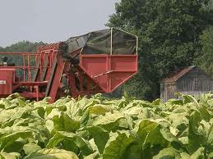
Is Mechanical Harvest Coverage a part of my current policy?
YES

Slide 40
Crop-Hail / Wind Fills
The Gap
Hail is the one catastrophe that is most likely to totally destroy a part of your crop and leave the rest looking fine. The part hail takes out may well be less than the deductible of your Multiple Peril Crop Insurance policy.
MPCI protects investment, not profit
Hail coverage provides:
  Profit Coverage
  Coverage for reduction in yield from 1% to 100%
Combination of MPCI and Hail provides you the best protection at the most affordable cost
Auto Crop Schedule (ACS) available in VA and NC
Supporting MPCI policy desired at least CAT level of coverage
Available for all crops

Slide 41
Proposed All-Risk Package for:
Any Farmer
Crop: Tobacco Yield: 2500 Interest: 100% | Type: Flue Acres: 1.0 | County: Any Hail: With | Price Election: 1.75 Value of Crop: $4000
MPCI and Storm Package Loss | 70% Level MPCI Coverage | Basic Hail Form (No Deductible) | Total Coverage
5% |  | $70 | $70
10% |  | $140 | $140
15% |  | $210 | $210
25% |  | $350 | $350
35% | $270 | $490 | $760
50% | $1,100 | $700 | $1,800
55% | $1,350 | $770 | $2,120
70% | $2,150 | $980 | $3,130
90% | $3,200 | $1260 | $4,460
100% | $3,800 | $1400 | $5,200
Liability | MPCI Per Acre: $3,800 | Hail Per Acre: $1,400 | Total: $5,200
Notes:
THIS SLIDE HAS TO BE UPDATED BEFORE IT IS USED AGAIN!!!!

Slide 42
New Guidelines for Quality Adjustment
Flue Cured and Burley Tobacco
We have included below language taken directly from the Loss Adjustment Manual (LAM) Section G (1).
The insured must contact the insurance company before any damaged tobacco is disposed of (sold or destroyed) so the tobacco can be inspected to determine the amount of tobacco that may be eligible for quality adjustment. If the insured disposes of any damaged tobacco without giving the company the opportunity to inspect it, such tobacco will not be eligible for quality adjustment.
C) Quality adjustment is allowed only if:
1. The insured obtained an assigned grade for the tobacco and the assigned grade appears on the discount factor (DF) chart in the Special Provisions; and
2. The tobacco is graded by a tobacco grader who is employed by the Agricultural Marketing System (AMS) or successor agency who assigns a grade in accordance with USDA Official Standards Grades.
Example: Insured has 1000# of tobacco graded. Adjuster pulls and submits sample. Sample results in a B4G being assigned. A B4G carries a DF of .400. The PTC will be 600# (1.000-.4000 =.600 x 1000# = 600# PTC).
A DF chart will be sent out to all Flue and Burley insured's after your acres are reported.
Dark Fired
Dark Fired QA will be calculated the same as in 2011. In order to qualify for QA, the unit must average less than 75% of price election ($2.10) which is $1.55 ($2.60 x .75=$1.58).
Example: 1000# in a unit averages $1.20. The PTC will be 582# ($1.20/$2.10 =.571# x 1000# = 571# PTC).

Slide 43
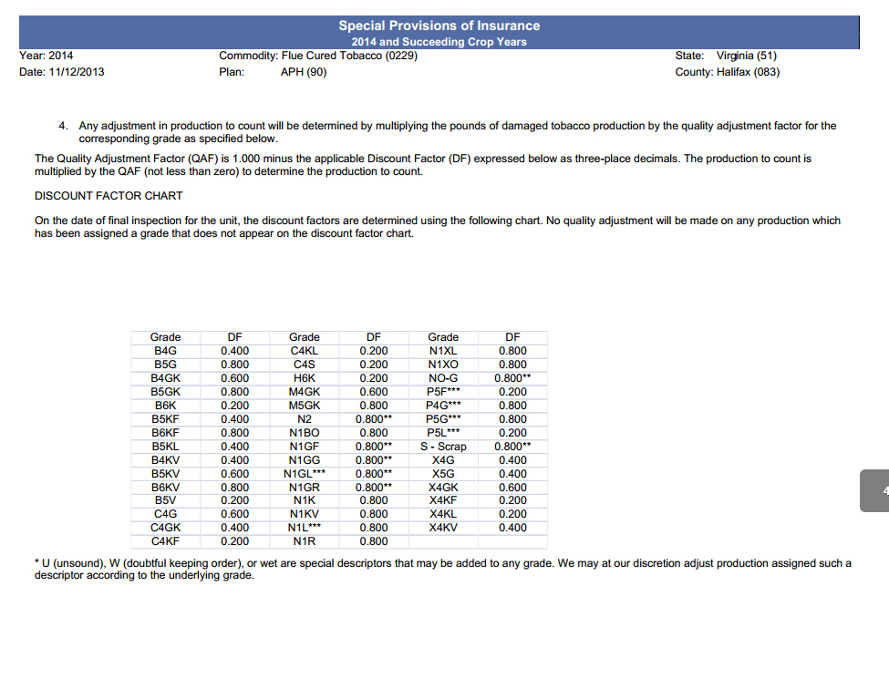

Slide 44
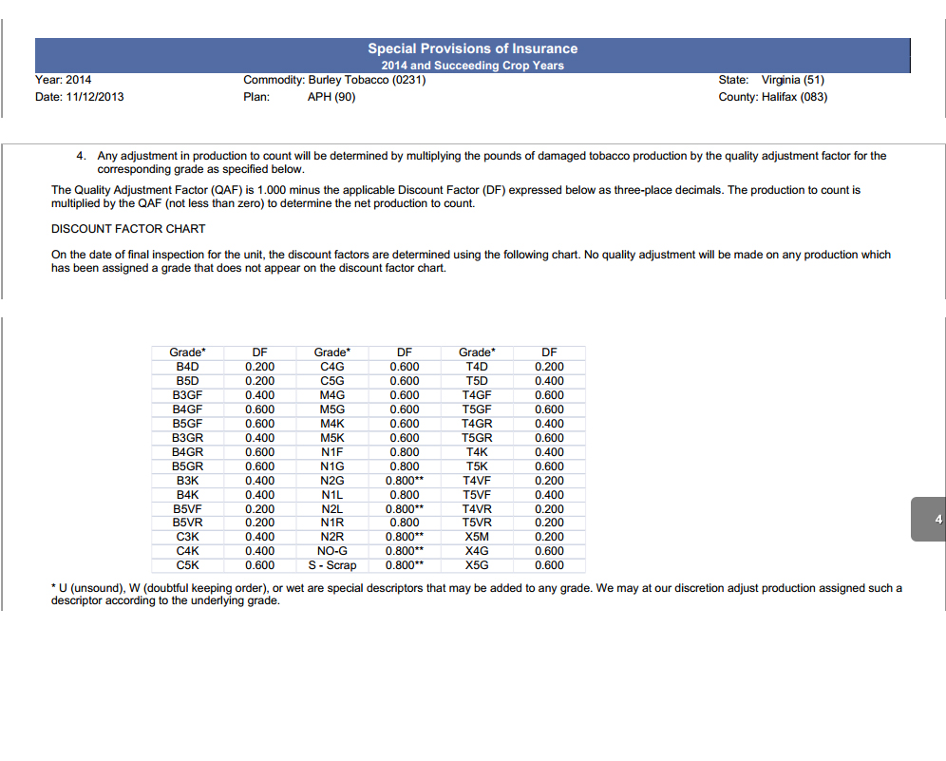

Slide 45
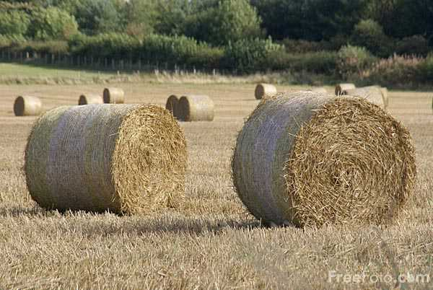
Pasture, Rangeland and Forage (PRF)
Payout as of 1/13/14
$683,357,576

Slide 46
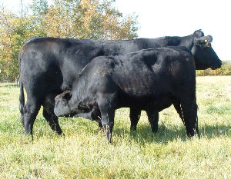
Livestock Risk Protection (LRP)
Payout For 2012
$34,202,370

Slide 47
New Breaking Ground
  Definition: Acreage not planted and harvested in one of the three previous crop years or acreage where the only crop has been planted and harvested in one of the three previous crop years was a cover, hay, or forage crop.
    Status: Not insurable unless:
      Acres are emerging from CRP within the two most recent crop years
      Acreage was not planted in at least two of the three previous crop years to comply with any other USDA program
      Such acreage constitutes 5% or less of the insured planted acreage in the unit
      Due to Rotation Requirements
      Provide us with the following by ARD
          Copy of 578 or 578PP from FSA that proves that the land has been planted in the past to a row crop (only need one year).
          FSA map marked as to the crop and where crop will be planted on NBG.
          NRCS conservation plan on NBG: You must provide documentation that one is, or will be, in place. If NRCS does not require a conservation plan, you must certify that one is not required.
      WA required by SCD if exceeds 320 acres
    You will receive (if approved) either 80% of county T-Yield or 65% county T-Yield
    Note: -Production must be kept and reported separately only for the first year.
    -Stay one year ahead to avoid land being declared as NBG.
    -Have another entity plant a crop on NBG acreage.
    -You do have the option to not insure the first year.

Slide 48
Acreage Report
Your acreage report is the key to your policy
Report ALL crops to FSA first
    FSA Maps
      Adjust field boundaries if necessary
      Remove areas of a field not planted
  Crop Insurance and FSA data must match
Obtain copy of 578 Producer Print (PP) forward to us
Review Schedule of Insurance
  Report any errors immediately

Slide 49
At Loss Time
Provide timely notice
  Policy provisions state you need to notify us within 72 hours of your initial discovery of damage or at least 15 days prior to or during harvest
  You must leave approved inspection strips for appraisal if crop is being destroyed or put to another use other than originally intended
    Not needed if adjuster can make an immediate appraisal
You must provide acceptable records of production
  Weigh tickets/Settlement sheets
    Cannot have a split load or a receipt without a backup farm management record
Quality adjustment requirements for grain
  Mycotoxins
    Verification
      Producer obtains a sample/verifies there is a problem
        Producer test kits, State Dept. of Agriculture, Extension Services
      Producer notifies us of the results
    Certification
      Third party (adjuster) must obtain a sample for each unit
        Sends sample with payment to certified lab for results
      Results determine quality adjustment

Slide 50
Aflatoxin level in excess of 300 ppb, Vomitoxin level in excess of 10ppm. A claim will not be completed until such production is sold, or destroyed.
Aflatoxin samples must be obtained before grain is put into storage. Vomitoxin samples may be obtained from storage.
If production qualifying under Section C3 is destroyed in a manner acceptable to us, the DF will be 1.000. For production destroyed in a manner unacceptable to us, production will not be adjusted for any quality deficiencies listed in Section C.
The DF for unsold production
            DF for Vomitoxin:
              Vomitoxin Range DF
              2.1 – 10.0 ppm 0.240-0.450
            DF for Aflatoxin:
              Aflatoxin Range DF
              20.1 – 300.0 ppb 0.100-0.400

Slide 51
Key Points to Remember
Important dates/time lines
  Refer to policy information sent annually or give us a call
    Sales Closing
      Make changes
    Acreage Reporting
      FSN
        All FSN’s must be reported
          Penalty for not reporting
      Acres
        All insured and uninsured acres must be reported
          Penalty for misreported acres
      Date Planted
        Know your Final Plant and Late Plant dates for each crop

Slide 52
Key Points continued…
  Prevented Plant
    Must be reported timely
  All documents must be the same
    Policy
    FSA
        Report all crops to FSA
        Make crop report from 578 PP or send to us
    Sales Receipts
Loss Reporting
Report any suspected loss immediately
  Adjuster will provide you with options
  Do not destroy crop or put to another use until adjuster gives approval

Slide 53
Key Points Continued…
Carry over production (old crop) MUST be measured by an adjuster before new crop is added to bins where old crop is stored.
Production Reporting
  Know the rules
    Acceptable production records
    All insured and uninsured production must be reported
  Report as soon as harvest is complete
Premium due date
Provide new FSN’s early, don’t wait until acreage reporting
Reconstituted farms due to us 45 days after sales closing
Review schedule of insurance
  Notify agent immediately of any errors
Know your policy provisions
Be timely and accurate

Slide 54
Problems Encountered and How to Avoid
Our goal at loss time is to get you paid correctly and promptly with an emphasis on making sure you get paid the maximum amount as allowed by the policy.
Listed below are problems (P) experienced this past crop year with corrective action (CA).
P- Crops put to another use or destroyed; or production disposed of without consent by an adjuster.
CA – Adjuster must appraise a crop if it is being destroyed or put to a use other than what it was initially intended for (e.g. wheat/soybeans insured as grain, but cut for hay; corn insured as grain, but chopped for silage).
If a crop is rejected at market and declared of no value by adjuster, the adjuster must inspect crop and verify it is disposed of in an approved manner.
P – Acreage and production not reported timely
CA – Know your acreage and production reporting dates. Open any correspondence from us immediately that is stamped: DATED MATERIAL OPEN IMMEDIATELY. Address the request and return by the date requested.
Now, all of our documents have to be scanned and forwarded to the company. Documents forwarded to you are date stamped. This means that getting them processed in a timely matter is more critical.
  Acreage Report – Report all crops to FSA. Obtain a 578 Producer Print (PP) and forward to us. USDA is currently streamlining acreage report dates (ARD’s) for FSA & RMA to be the same.
Production Report- All production reports are due 45 days after sales closing. We encourage all producers to turn in production as soon as harvest is complete or sales are complete.

Slide 55
Problems Encountered and How to Avoid continued…
P- Misreported acres or crops on acreage report. These types of errors can carry a huge penalty at loss time and in cases could knock a producer completely out of a loss.
CA - Carefully go over your acreage report after you receive your 578PP from FSA. Make sure FSN’s match and ensure that the correct crop and acres are allocated to the correct fields.
Review Schedule of Insurance when you receive it. Notify us within 10 days of any known errors.
P- Documents sent for signature not returned or not returned timely.
CA- Open, complete, and return ALL correspondence marked: DATED MATERIAL OPEN IMMEDIATLEY.
P- Not notifying agent of changes during the crop year. These changes could range from an entity change, marital status, address, phone number, etc.
CA- Notify us of any change as you become aware of it. Penalties could range from reduced coverage to no coverage.
P- FSA reconstitution not reported to us timely.
CA - Notify us of any reconstitutions as soon as possible, but no later than 45 days after sales closing.
P- Enterprise Unit (EU) qualifications not being met.
CA- To qualify for EU, a farmer must plant on at least two separate farm serial numbers within a county to the insured crop, and the acreage on at least two farms or an aggregate of multiple farms must represent 20% of the total planted acreage of the crop in the county or 20 acres, whichever is lesser.
P – Proper notification not given before a crop eligible for a replant payment was replanted.
CA – Notify our agency before any crop is replanted. An adjuster will be in touch with you promptly to give you the “go ahead” to replant.
P – Post Harvest Inspection not completed. Claim will be denied if inspection is not made.
CA – Call adjuster or our agency for:
- tobacco stalk or stubble inspection
- cotton stalk inspection
- fresh market tomato post-harvest inspection

Slide 56
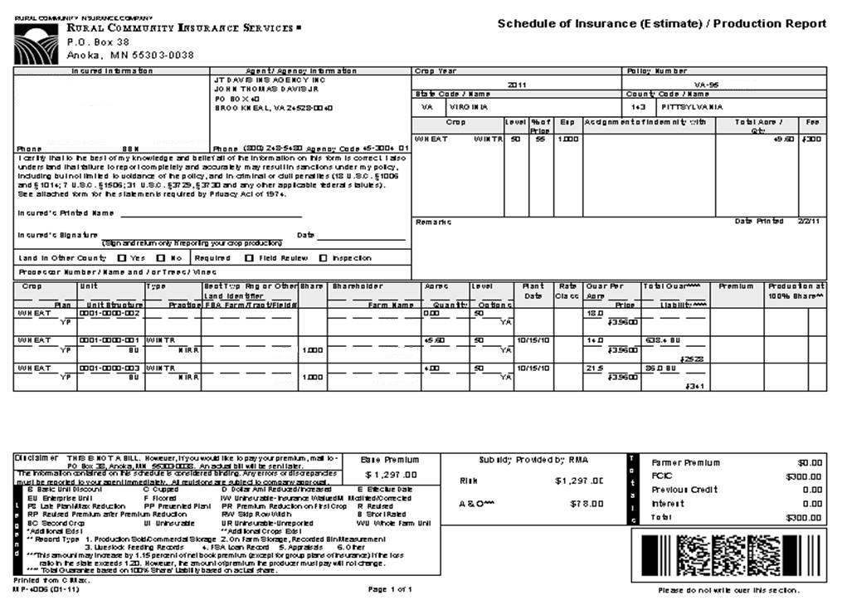

Slide 57
APH Review Trigger
Corn: RP Prac: NIRR Type: Grain Unit: 001-01-00 Shareholder: Record Type: | County: Halifax FSN: 5350 Farm Name: River Farm Tran Yld: 75.0
Remarks: YA = Adjusted Yield (60% T)
 | Additional Land Locations: Sec Twp Rng FSN 6969 Simple (Rate) Yld 101.0 Date Signed 10/26/2011
1) Yields of 150% - 250% of prior
yield triggers 5% random
company review (5% of all units
will be selected by computer.)
2) Yields of 400% or greater above
County T-Yld triggers automatic
review by RMA.
YEAR | PRODUCTION |  | ACRES | YIELD
1995 | 87196.8 |  | 703.2 | 124.0 | A
1996 | 91827.0 |  | 758.9 | 121.0 | A
1997 | 90588.6 |  | 767.7 | 118.0 | A
1998 | 4660.0 |  | 465.9 | 10.0 | YA
1999 | 178112.0 |  | 1113.2 | 160.0 | A
2000 | 8667.0 |  | 722.3 | 12.0 | YA
2001 | 28621.6 |  | 188.3 | 152.0 | A
2002 | 86294.0 |  | 1121.0 | 77.0 | A
2003 | 14808.0 |  | 239.6 | 62.0 | A
2004 | 220091.0 |  | 1283.6 | 171.0 | A
Prior Yld | 99.0 |  | Avg Yld | 108.0
3) Production losses above $200,000 on a crop by policy requires an automatic APH review.

Slide 58
Short Notes
2014 Price elections
For VA |  | 2013 Prices
Flue | $2.15 | $1.75
Burley | $2.05 | $1.80
Dark | $2.10 | $2.07
Fresh Mkt. Tomatoes | $6.85 | $ 6.80
Corn | $4.62 | $ 5.65
Soybean | $11.41 | $12.91
Grain Sorghum | $4.46 | $ 5.53
Data mining used to determine anomalies
  Trigger GSI’s

Slide 59
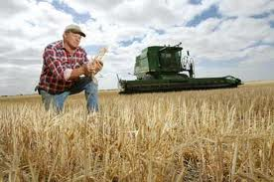
What Does
J.T. Davis Insurance Agency Offer?
47 years personal experience
6 office personnel to serve you with combined experience of 112 years
Devoted 100% to crop insurance
Individual risk management planning
Experienced, competent adjusting staff
Fast claim turn around
  Direct deposit
E-Business access
Toll free 800 service
Represents the #1 insurance provider
  RCIS
    Subsidiary of Wells Fargo and Company
    AM best rating “A”
Visit us on the web at: www.jtdavisins.com

Slide 60
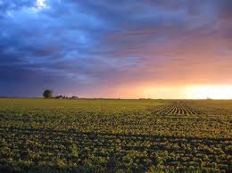
Risk Management
It is your responsibility,
Let Us Help…
…It’s what we do

Slide 61
Crop Insurance 2014
Questions???

