Slide 1
J.T. Davis
Insurance Agency Inc.
2014 Customer Appreciation Meeting

Slide 2
We appreciate the opportunity to serve your crop insurance needs

Slide 3
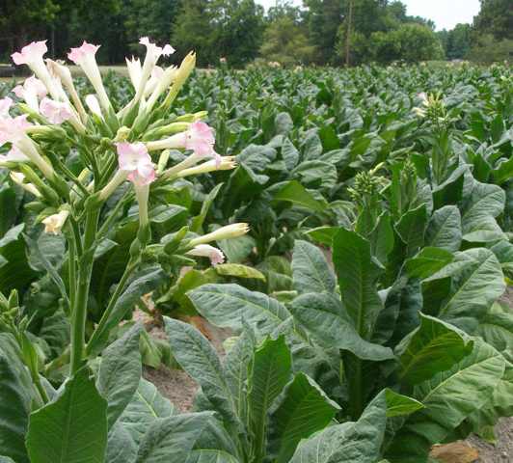
Tobacco
Crop Rotation rule has been removed
Quality Adjustment
Modified for least valuable grades
Must have tobacco graded by a USDA grader through Tobacco Administrative Grading Service (TAGS)
(855)776-8570
www.tobaccograding.com
Cost is approximately $0.02/lb.
Stalk/Stubble Inspections
Must be made if you have a loss or anticipate a loss
Claim will be denied if stalks/stubbles are destroyed before inspection is made
If uncertain of a loss, leave stalks in place
Growing Season Inspections (GSI)
Trigger - 3 losses within the last 5 years
- Inconsistent yields
Appraisal may be used to determine production to count
Data mining used to determine anomalies
Trigger GSI’s

Slide 4
Tobacco
Year | Flue Cured Loss Ratio Totals (National)
2012 | 1.08
2011 | 4.54
2010 | 2.25
2009 | 2.00
2008 | 2.46
2007 | 2.38
2006 | 3.55
2005 | 2.67
2004 | 1.63
2003 | 3.21

Slide 6
Key Points
Crop Insurance fraud is growing in North Carolina tobacco.
Tobacco growers could loose crop insurance in future as result.
USDA wants growers to help control the bad behavior.

Slide 7
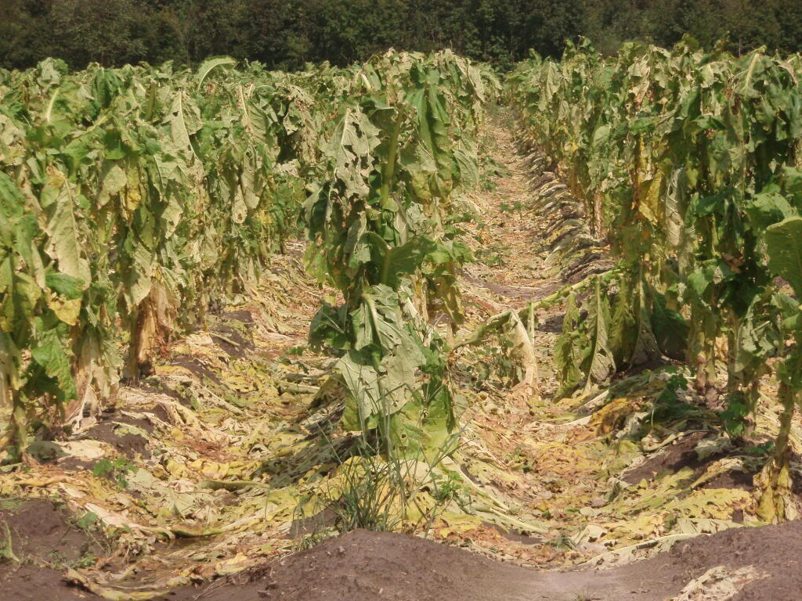
Crop Hail
General Information

Slide 8
Crop Hail
All tobacco acreage can be insured
NBG
Pays spot losses
Lower deductible than MPCI
0%-10%
Pays replant payment
Only way you can insure up to ACV
Combination of MPCI & CH
Optional wind coverage available

Slide 9
Crop Hail
Coverage available for other crops
Small grains
Coarse grains
ACS available
Continues coverage
Write early
Coverage effective at 12:01 a.m. the second day after signature is obtained

Slide 10
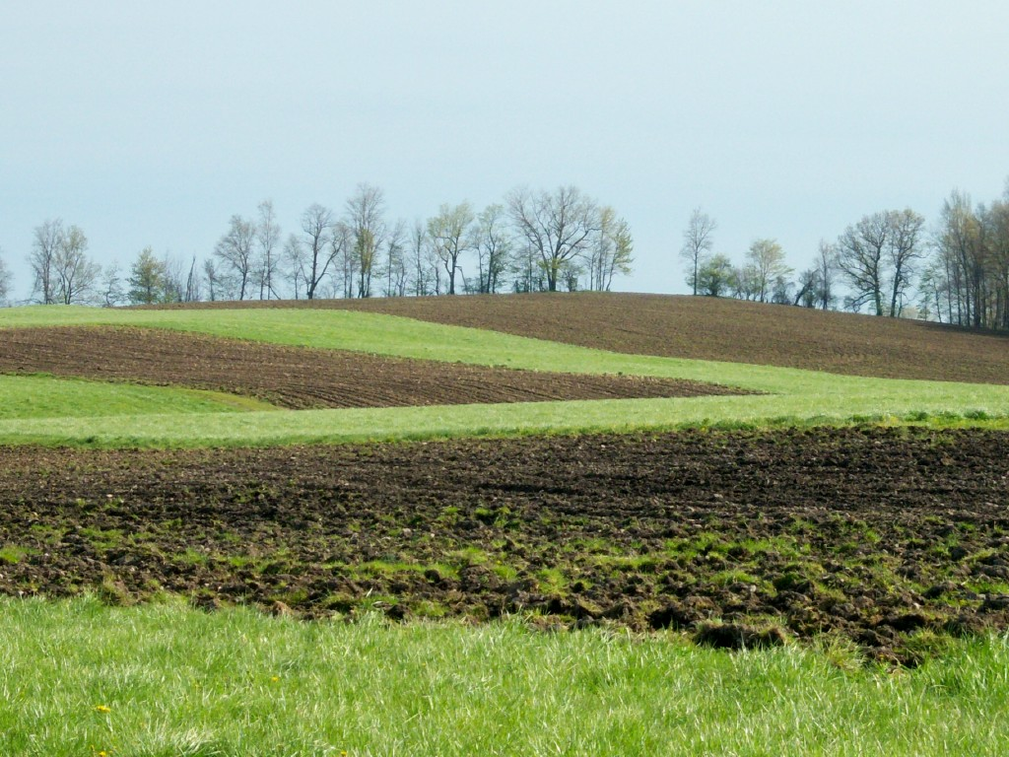
New Breaking
Ground
Explanation & Requirements

Slide 11
New Breaking Ground
Definition: Acreage not planted and harvested in one of the three previous crop years or acreage where the only crop that has been planted and harvested in one of the three previous crop years was a cover, hay, or forage crop.
Status: Not insurable unless:
Acres are emerging from CRP within the two most recent crop years
Acreage was not planted in at least two of the three previous crop years to comply with any other USDA program
Such acreage constitutes 5% or less of the insured planted acreage in the unit
Due to Rotation Requirements
Provide us with the following by ARD
Copy of 578 or 578PP from FSA that proves that the land has been planted in the past to a row crop (only need one year).
FSA map marked as to the crop and where crop will be planted on NBG.
NRCS conservation plan on NBG: You must provide documentation that one is, or will be, in place . If NRCS does not require a conservation plan, you must certify that one is not required.
WA required by SCD if exceeds 320 acres
You will receive either:
80% of county T-Yield if you provide records or
65% county T-Yield if you can not provide records
Note: - Production must be kept and reported separately only for the first year. - Stay 1 year ahead to avoid land being declared as NBG -Either you or another entity plant a crop on NBG acreage - You do have the option to not insure the first year

Slide 12
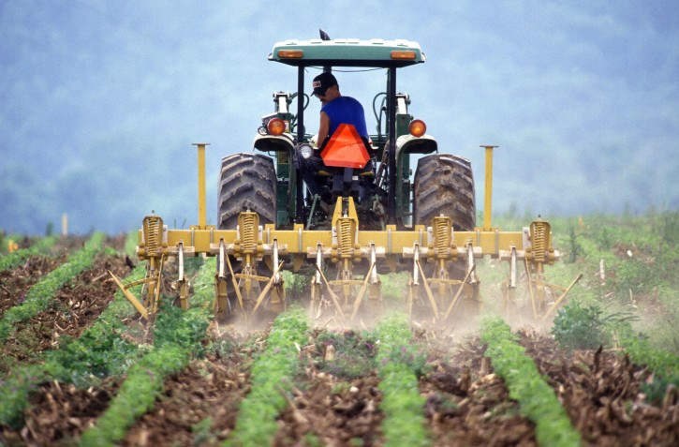
New Producer
Status
Qualifications

Slide 13
RMA New Producer Status Review
New producer
Has not grown the crop in the county OR has not grown the crop in the county more than two years and can provide acceptable records for years grown
Receive 100% of T-Yield
Has grown crop but not in the past ten years and does not have records
Submit RMA RO determine yield request before PRD
Receive 100% of T-Yield
RMA uses data mining to verify new producer qualification
FSA records
AIP records
AIP has to verify all new producer status
Penalty
If you did not qualify, by review, and had a claim you will have to pay money back
Should you elect not to pay money back or do not pay by deadline
Crop insurance policy will be terminated
Put on ITS list
Ineligible for certain USDA/FSA program benefits

Slide 14
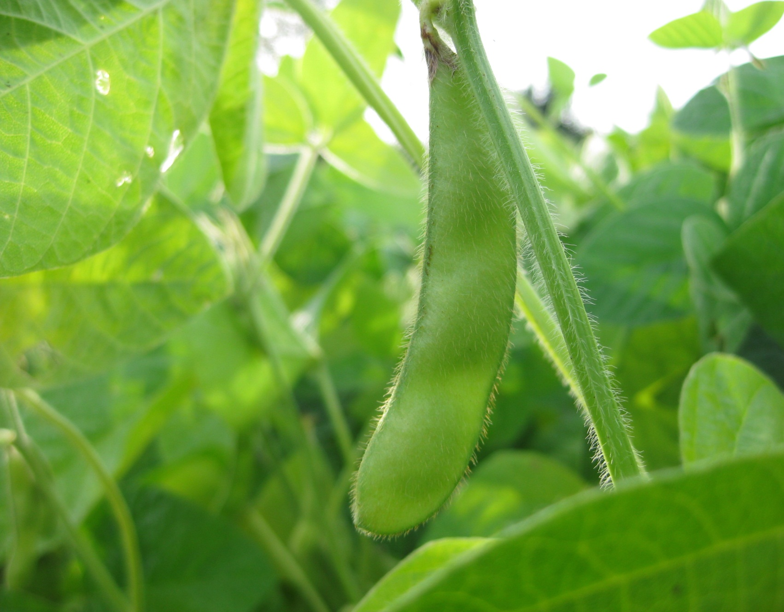
Replant
Payments
Requirements

Slide 15
Replant Payments
Must submit a timely notice of loss and an adjuster must give you an approval BEFORE crop is replanted
20/20 rule applies
Must replant a minimum of 20% of unit or 20 acres whichever is lesser

Slide 16
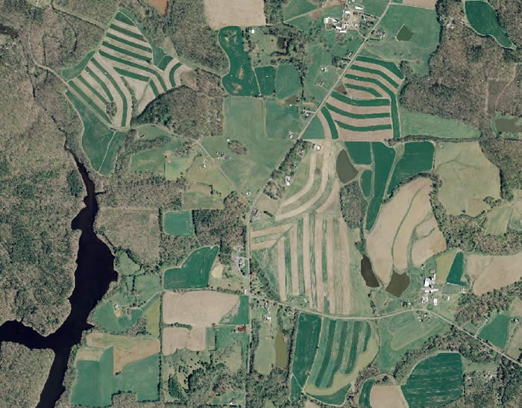
Enterprise
Units

Slide 17
Enterprise Units
60% Discount
Enterprise Unit- all farms in a county combined into one unit
Qualifications
Plant on at least 2 FSN’s
A minimum of 20 acres or 20% of the unit planted, whichever is the lesser, on at least two FSN’s or an aggregate (multiple) of farms
660 acres on a single FSN
Examples:
Qualifies: FSN 1 – 8 acres, FSN 2 – 2 acres
Qualifies: FSN 1 – 8 acres, FSN 2 – 1 acre, FSN 3 – 1 acres
DOES NOT QUALIFY: FSN 1 – 9 acres, FSN 2 – 1 acre

Slide 18
Prevented Plant Claim Procedure
Timely notice loss
Within 72 hours of late plant date or final plant date if no late plant date exists or within 72 hours of your decision not to plant
20/20 rule applies
Acres planted, not insured, and intended for another use will count against eligible acres.
Black Dirt Policy
Cover Crops
Call us if you plan to plant a cover crop
Soybeans as a cover crop
Written recommendation from an agricultural expert
Should not be planted during late plant period

Slide 19
Double Crop Verification
Policy language states that in order for a producer to receive two 100% payments in a crop year, the policy holder must provide acceptable records of acreage and production that show the policyholder double cropped acreage in at least two of the last four crop years in which the crop was planted.
Proof of Production
Obtain settlement sheet from buyer
Retain in a crop year folder
Or we will retain for you
For production not sold, acceptable farm management records must be retained

Slide 20
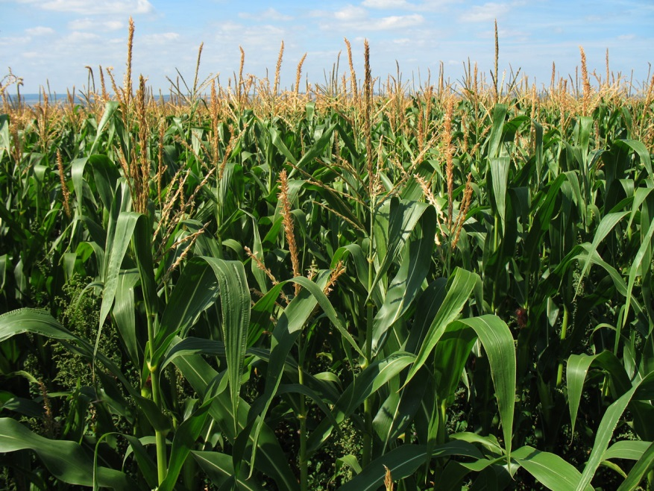
Corn Silage
Insure as grain/chop for silage
Appraisal must be done
Insure as silage/chop for silage
Loss
Appraise or
Use Load Records
Adjuster must approve
Adjuster measure stored production
No Loss
Appraise or
Use load records
Measure stored production
Adjuster or FSA

Slide 21
Organic Requirements
Certificate
Organic Plan
If you have a loss
Copy of most recent inspection required

Slide 22
Replant Option Policy (RO)
Virginia
Corn
Eligible for “early bird” coverage in RO Policy section 4.a.i.
Earliest plant date/ Halifax Co, Va.
RO 3/26
W/O RO 4/16
 | 2013 RO Premium Per Acre
2013 IPA | A | B
$10 | $0.35 | $0.60
$20 | $0.70 | $1.20
$30 | $1.05 | $1.80
$40 | $1.40 | $2.40
$50 | $1.75 | $3.00

Slide 23
Replant Option Policy (RO)
Virginia
Soybeans
Eligible for “early bird” coverage in RO Policy section 4.a.i.
Earliest plant date/ Halifax Co. Va.
RO 3/25
W/O RO 4/15
 | 2013 RO Premium Per Acre
2013 IPA | A | B
$10 | $0.50 | $1.00
$20 | $1.00 | $2.00
$30 | $1.50 | $3.00
$40 | $2.00 | $4.00
$50 | $2.50 | $5.00

Slide 24
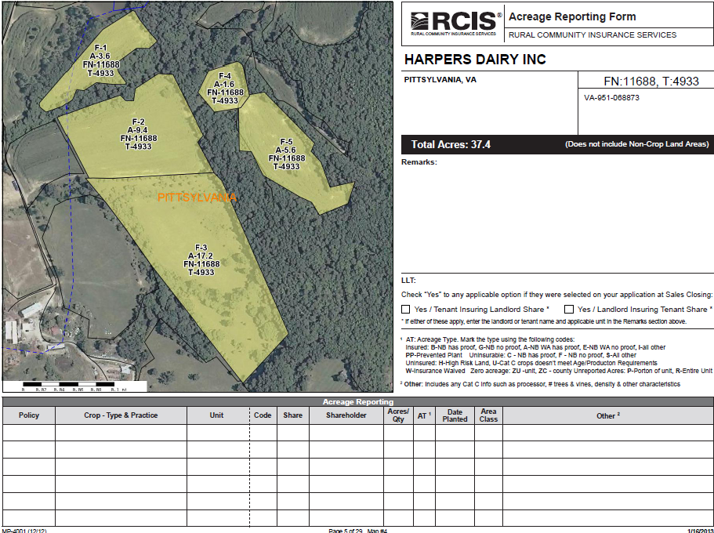
Farm Maps
Multiple uses
Acreage reporting
Record keeping
GAP
Planting
Plant date
Seed variety
Plant population
Fertilizer/Chemical
Production
Notes

Slide 25
Yield Trend Adjustment
Yields have generally trended upwards due to:
Improved genetics/hybrids
Seed companies claim that, on average, corn yield potential will increase 2 bu. per acre, per year due to genetic improvements
Precision farming equipment
Better farming practices
Better pest and weed management
Available for coarse grains in select counties
Not available for CAT policies, corn insured as silage, or specialty type soybeans.
Not available for new producers.
Must have one year of actual yield in four most recent years to qualify
Each database considered separately
TA yield factors reduced if APH database contains fewer than four actual yields in twelve most recent policy crop years
Cups and yield floors not applicable

Slide 26
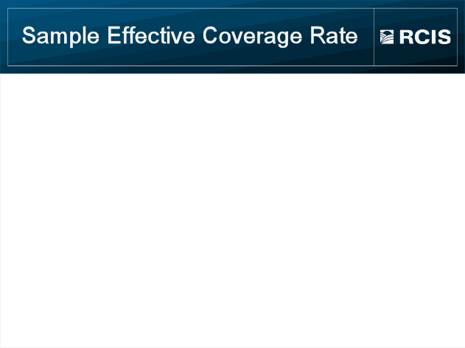
Sample data is from the RMA Cost Estimator Example v 11.4 16 NOV 2011
Actual Yield = 121 bu/ac Trend-Adjusted Yield = 135 bu/ac
Level | 75% | 75% w/TA | 84%* | 85%
Base Rate | 0.16235064 |  |  | 0.22600071
TA Base Rate |  | 0.21890186 | 0.21890186
Bushel Guarantee | 91 | 101 | 101 | 103
Subsidy | 0.55 | 0.55 | Not Applicable | 0.38
Liability | $546 | $606 | $606 | $618
Farmer Premium | $43 | $59 | $93 | $94
Cost/$100 | 0.079 | 0.096 | 0.152 | 0.153
*Actual coverage level not available

Slide 27
Short Notes
2014 Price elections
For VA |  | 2013 Prices
Flue | $2.15 | $1.75
Burley | $2.05 | $1.80
Dark | $2.10 | $2.07
Fresh Mkt. Tomatoes | $6.85 | $ 6.80
Corn | TBD ($4.58) | $ 5.65
Soybean | TBD ($11.15) | $12.91
Grain Sorghum | TBD ($4.43) | $ 5.53

Slide 28
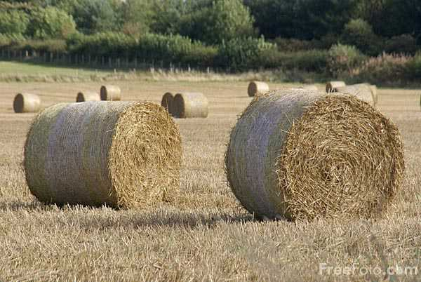
Pasture, Rangeland, and Forage (PRF)
Payout as of 1/13/14 $683,357,576

Slide 29
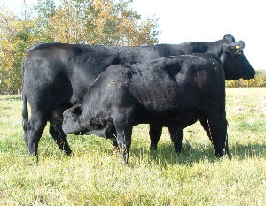
Livestock Risk Protection (LRP)
Payout For 2012
$34,202,370

Slide 30
Key Points
Review

Slide 31
Key Points to Remember
Production Reporting
Report as soon as all sales are completed.
All production (insured and uninsured) MUST be reported
Obtain settlement sheets on all crops and retain
Acreage Reporting
Be accurate
Be Timely
Report to FSA FIRST
Obtain copy of 578PP
Forward to us
Identify ALL uninsurable acres
NBG (New Breaking Ground)
Practice uninsurable
Ex. wheat for fallow or hay, soybeans for hay
Crops planted after late plant date
Insurable IF planted late due to insurable cause of loss
60% of timely plant guarantee
Can elect to not insure

Slide 32
Key Points to Remember
Settlement sheets for all production MUST be supplied to adjuster before final can be completed
Provide timely notice of loss
Within 72 hours of occurrence
Report each occurrence of a loss
Report entity changes when they occur
Marital status
Trading as corporation, LLC., etc.
SBI change
Quality losses on grain
Mycotoxins
Notify us immediately
Map Book will be mailed prior to Spring planting
Retain and use for Fall plantings

Slide 33
Questions

