Slide 1
J.T. Davis
Insurance Agency Inc.
2016 Customer Appreciation Meeting

Slide 2
We appreciate the opportunity to serve your crop insurance needs.

Slide 3
Conservation Compliance
Conservation Compliance Linked to Premium Assistance
You must have a current AD-1026 on file in order to receive premium assistance for 2016 crop year.
In order to be in compliance for premium assistance you must:
Be in compliance with a NRCS approved conservation plan for all Highly Erodible Land (HEL).
Not plant or produce an agricultural commodity on a wetland converted after February 7, 2014.
Not have converted a wetland after February 7, 2014 to make it possible to produce an agricultural commodity.
If your operation contains HEL or Wetlands and you are planning any activity that may affect your compliance status, you must notify NRCS! You will be allowed time to comply with any new plan(s).
ANY change to your farming operation will require a new AD-1026 will be required. Please contact FSA.

Slide 4
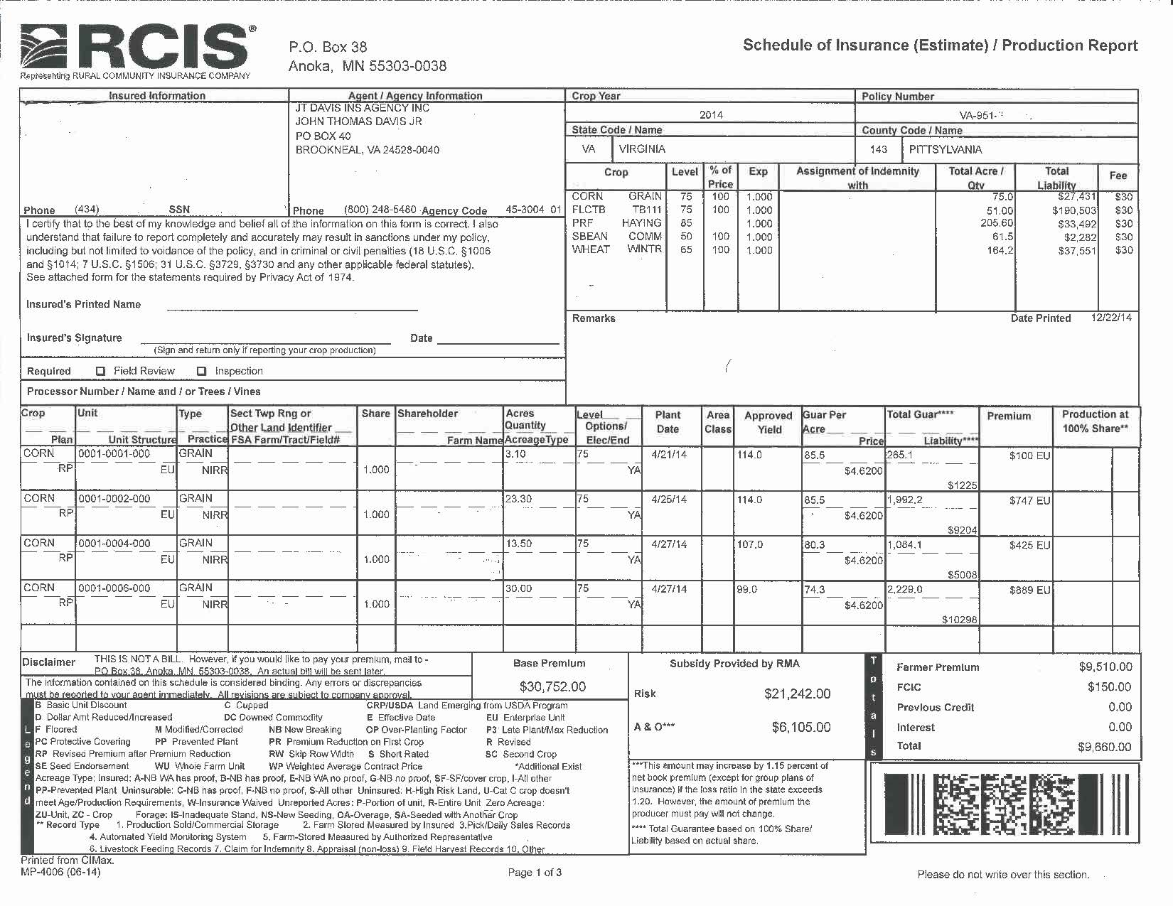
Highlights of the 2014 Farm Bill (cont’d)
The following is an excerpt from an actual schedule of insurance showing the effect of premium assistance.

Slide 5
Crop Insurance Changes for 2016
Yield Exclusion Now Available for Tobacco
Beginning with the 2016 tobacco crop, yield exclusion will be available for tobacco in qualifying counties.
In order to qualify the county average yield for the crop must be at least 50% below the simple average of the planted acre yield for the previous 10 consecutive years.
It is an area determination made by RMA and is not based on your individual yields.
There are no qualifying counties for flue tobacco in our area, but Southwest Virginia and Tennessee do have several counties that qualify for Burley yield exclusion.
Final Harvest Date Set for Burley
Burley tobacco must be harvested and hung in a curing facility not later than October 20th.
You must notify us no later than October 20th if you do not intend to harvest any of your insured acreage.
Any Burley tobacco not harvested by October 20th:
Will not be eligible for quality adjustment;
Will be considered to have been damaged solely by uninsured causes unless it is appraised by us (our appraisal will be used in determining any indemnity you may be due); and
Will not be covered for any cause of loss that occurs after October 20th.

Slide 6
Crop Insurance Changes for 2016 (cont’d.)
Price Elections
Conventional Tobacco will be $1.80 for Flue and Burley; $2.15 for Dark Fired.
Certified Organic Tobacco will be $3.85 for Flue and Burley.
Certified Organic Tobacco can be insured at the contracted price. The maximum contract price for Flue and Burley is $5.77. The maximum contract price for Dark Fired is $4.30.
SCO is Now Available for Tobacco
Quality Adjustment Changes for Flue and Burley Tobacco
Grades that previously would have received an 80% Discount Factor will now be assigned a Zero Market Value and will be required to be destroyed.
If you choose not to destroy this production, no adjustment to production to count will be made for quality.
Flue Tobacco Discount Factor Chart
Grade | DF | Grade | DF | Grade | DF
B4G | .0400 | C4KL | 0.200 | N1XL | **
B5G | ** | C4S | 0.200 | N1XO | **
B4GK | 0.600 | H6K | 0.200 | NO-G | **
B5GK | ** | M4GK | 0.600 | P5F*** | 0.200
B6K | 0.200 | M5GK | ** | P4G*** | **
B5KF | 0.400 | N2 | ** | P5G*** | **
B6KF | ** | N1BO | ** | P5L*** | 0.200
B5KL | 0.400 | N1GF | ** | S - Scrap | **
B4KV | 0.400 | N1GG | ** | X4G | 0.400
B5KV | 0.600 | N1GL*** | ** | X5G | 0.400
B6KV | ** | N1GR | ** | X4GK | 0.600
B5V | 0.200 | N1K | ** | X4KF | 0.200
C4G | 0.600 | N1KV | ** | X4KL | 0.200
C4GK | 0.400 | N1L*** | ** | X4KV | 0.400
C4KF | 0.200 | N1R | **

Slide 7
Crop Insurance Changes for 2016 (cont’d.)
Whole Farm Revenue Policy (WFRP) - Major Changes Make a More Versatile & Attractive Product
The 35% limit for Livestock and Animal Products has been removed, as well as the 35% limit for Greenhouse and Nursery. Producers may instead have up to 1 million dollars of revenue from either of these two categories.
The index for expanding operations is increased from 10% to 35%. The producer can also now opt out of indexing.
Expanded eligibility to include Beginning Farmers and Ranchers who have three years of Federal farm tax returns and farmed the year immediately prior to the insurance year.
Record requirements for direct marketers have been made easier and online tools are provided by RMA to assist with recordkeeping.
If you have specialty crops of economic significance this policy may be a good fit for you. Please contact us for additional information.

Slide 8
SCO Definitions
Area Loss Trigger - Always 86%
SCO payments are only due if the county or area yield and/or revenue is below 86%.
Expected Area Yield – The yield contained in the actuarial documents for the insured crop, type, and practice in the production area.
Expected Area Revenue – The Expected Area Yield multiplied by the Projected Price.
Expected Crop Value – The value of the crop based on your approved yields and the projected price or price election. For policies with Revenue Protection, the expected crop value may increase if the harvest price is higher than the projected price.
Final Area Yield – The yield as determined and released by FCIC. This yield is used to determine if a payment will be due.
Supplemental Coverage Range – The percentage difference between the underlying policy coverage and the 86% Area Loss Trigger

Slide 9
Supplemental Coverage Option - SCO
Supplemental Coverage Option (SCO) is now available for Flue and Burley Tobacco and for Grain Sorghum. SCO for Corn, Soybeans and Wheat is also offered. For grain crops Supplemental Coverage Option Endorsement (SCO) is designed to work with the Price Loss Coverage (PLC) program option from FSA. It is not available with ARC
SCO is a county-level policy endorsement that is in addition to an underlying crop insurance policy. It is designed to cover shallow losses in excess of 14% that would not be covered by the underlying policy. It covers the gap between the selected MPCI policy coverage level and 86% of the expected area yields, to help protect producers from yield and market volatility. It matches the underlying coverage in that it provides the same type of coverage, yield or revenue protection.
Any indemnities for SCO will be determined later than the indemnity process for the underlying policy, as the SCO indemnities are calculated following the release by FCIC of the final area yields and revenues. For most crops this will be in the spring of the subsequent year.
For those of you that are at the highest level of coverage, or want or need additional coverage under a Multi-Peril (MP) policy, this a viable option.

Slide 10
Beginning Farmer or Rancher
In order to qualify for these benefits you must not have actively managed or operated a farm for more than 5 years.
If this applies to you, please talk with us as soon as possible to see if you qualify.
There are exclusions for years under 18; years as a student; and years on active duty in the U.S. military.
There are substantial benefits if you qualify, including:
Exemption from Administrative Fees
An additional 10% of premium subsidy for buy-up policies
Use of the production history of farming operations where you were previously involved in decision making or physical activities
An increase in the substituted yield for yield adjustment from 60% to 80% of the county T-yield.

Slide 11
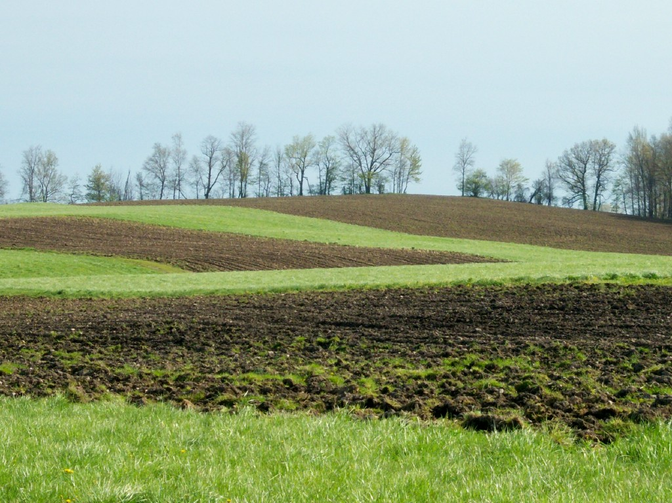
New Breaking
Ground
Explanation & Requirements

Slide 12
New Breaking Ground
Definition: Acreage not planted and harvested in one of the three previous crop years or acreage where the only crop that has been planted and harvested in one of the three previous crop years was a cover, hay, or forage crop.
Status: Not insurable unless:
Acres are emerging from CRP within the two most recent crop years
Acreage was not planted in at least two of the three previous crop years to comply with any other USDA program
Such acreage constitutes 5% or less of the insured planted acreage in the unit
Due to Rotation Requirements
Provide us with the following by ARD
Copy of 578 or 578PP from FSA that lists FSN, Tract, & Field #.
FSA map marked as to the crop and where crop will be planted on NBG.
NRCS conservation plan on NBG: You must provide documentation that one is, or will be, in place (only one year of proof required). If NRCS does not require a conservation plan, you must certify that one is not required.
WA required by SCD if exceeds 320 acres
You will receive either 80% of county T-Yield or 65% county T-Yield
Note: - Production must be kept and reported separately only for the first year. - Stay 1 year ahead to avoid land being declared as NBG
- Either you or another entity plant a crop on NBG acreage
- You do have the option to not insure the first year

Slide 13
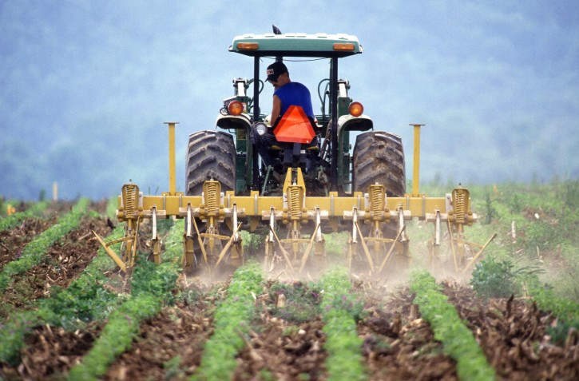
New Producer
Status
Qualifications

Slide 14
RMA New Producer Status Review
New producer
Has not grown the crop in the county OR has not grown the crop in the county more than two years and can provide acceptable records for years grown
Receive 100% of T-Yield
Has grown crop but not in the past ten years and does not have records
Submit RMA/RO determine yield request before PRD
Receive 100% of T-Yield
RMA uses data mining to verify new producer qualification
FSA records
Company records
API has to verify all new producer status
Penalty
If you did not qualify, by review, and had a claim you will have to pay money back
Should you elect not to pay money back or do not pay by deadline
Crop insurance policy will be terminated
Put on ITS list
Ineligible for certain USDA/FSA program benefits

Slide 15
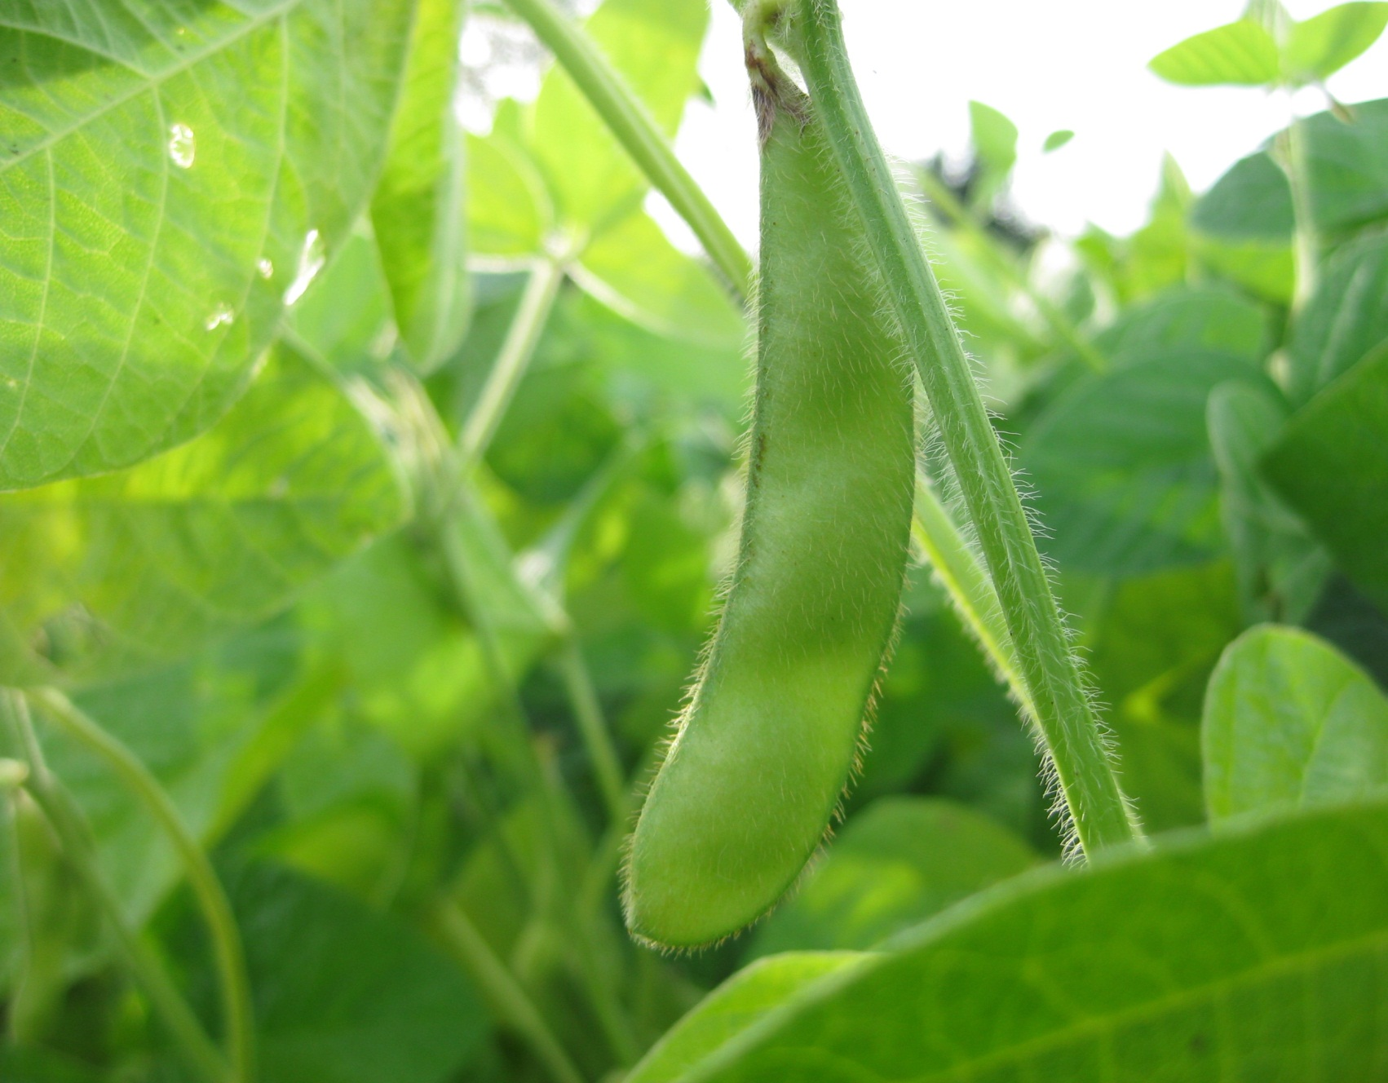
Replant
Payments
Requirements

Slide 16
Replant Payments
Must submit a timely notice of loss and an adjuster must give you an approval BEFORE crop is replanted
20/20 rule applies
Must replant a minimum of 20% of unit or 20 acres whichever is lesser
Do NOT replant before you speak with an adjuster.

Slide 17
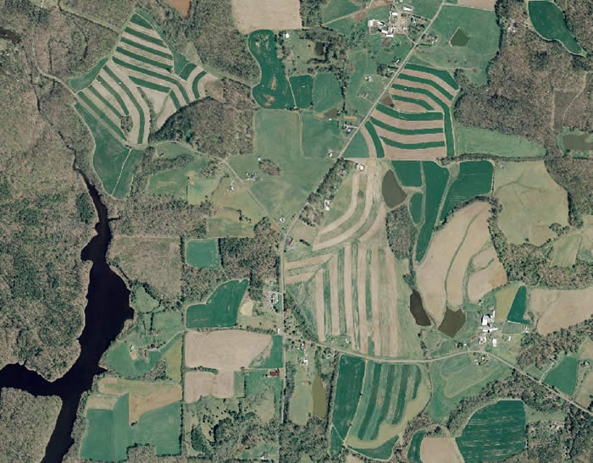
Enterprise
Units

Slide 18
Enterprise Units
Enterprise Unit- all farms in a county combined into one unit
New with the 2014 Farm Bill – You can have separate enterprise units for irrigated and non-irrigated practice.
You can have different levels of coverage on your irrigated and non-irrigated grain crops.
Both practices must qualify separately for the enterprise unit.
Additional 60% Discount
Qualifications
Plant on at least 2 FSN’s
A minimum of 20 acres or 20% of the unit planted, whichever is the lesser, on at least two FSN’s or an aggregate (multiple) of farms
660 acres on a single FSN
Examples:
Qualifies: FSN 1 – 8 acres, FSN 2 – 2 acres
Qualifies: FSN 1 – 8 acres, FSN 2 – 1 acre, FSN 3 – 1 acres
DOES NOT QUALIFY: FSN 1 – 9 acres, FSN 2 – 1 acre

Slide 19
Prevented Plant Claim Procedure
Timely notice loss
Within 72 hours of late plant date or final plant date if no late plant date exists or within 72 hours of your decision not to plant
20/20 rule applies
Acres planted, not insured, and intended for another use will count against eligible acres.
Black Dirt Policy
Cover Crops
Call us if you plan to plant a cover crop
Soybeans as a cover crop
Written recommendation from an agricultural expert
Should not be planted during late plant period

Slide 20
Double Crop Verification
Policy language states that in order for a producer to receive two 100% payments in a crop year, the policy holder must provide acceptable records of acreage and production that show the policyholder double cropped acreage in at least two of the last four crop years in which the crop was planted.
Proof of Production
Obtain settlement sheet from buyer
Retain in a crop year folder
Or we will retain for you
For production not sold, acceptable farm management records must be retained.
We appreciate all the cooperation with the campaign to relax these requirements. We will keep you updated.

Slide 21
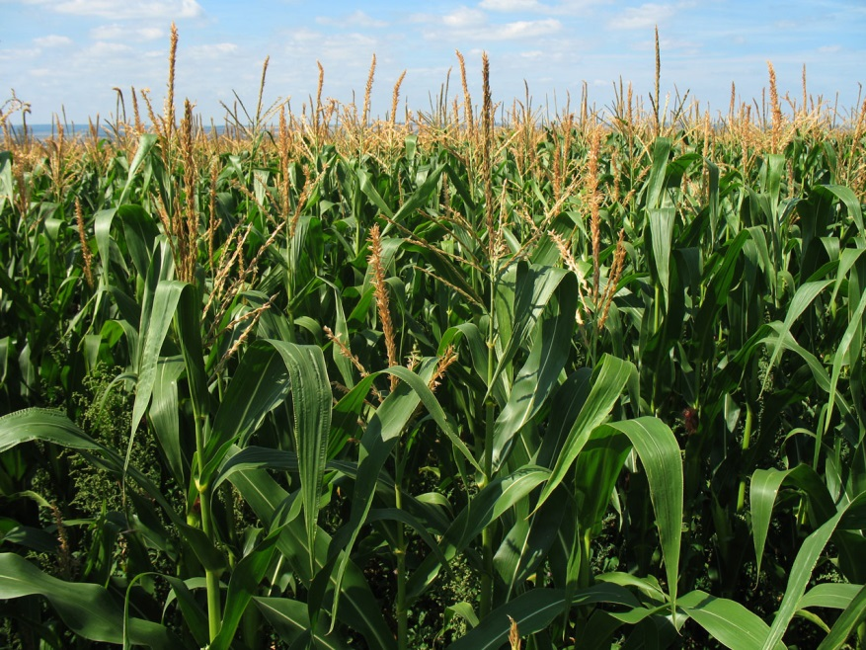
Corn Silage
Insure as grain/chop for silage
Appraisal must be done
Insure as silage/chop for silage
Loss
Appraisal must be done
No Loss
Appraise or
Use load records
Measure stored production
Adjuster or FSA

Slide 22
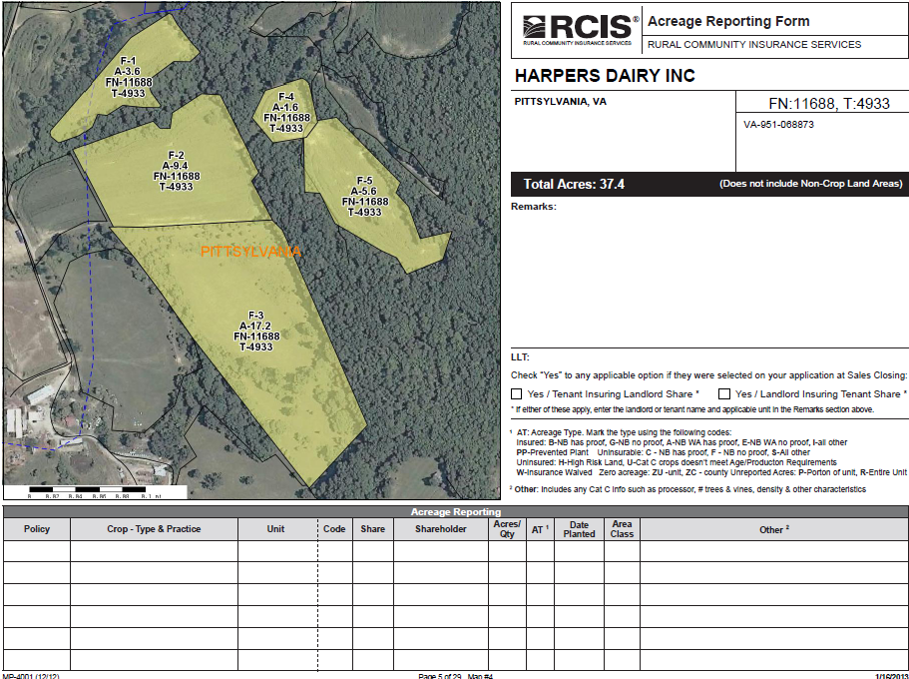
Farm Maps
Multiple uses
Acreage reporting
Record keeping
GAP
Planting
Plant date
Seed variety
Plant population
Fertilizer/Chemical
Production
Notes

Slide 23
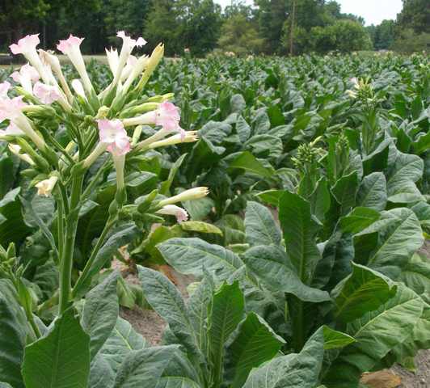
Tobacco
Quality Adjustment
Applies only to certain least valuable grades
Must have tobacco graded by a USDA grader through Tobacco Administrative Grading Service (TAGS)
(855)776-8570
www.tobaccograding.com
Cost is approximately 3½ cents per pound.
Stalk/Stubble Inspections
Must be made if you have a loss or anticipate a loss
Claim will be denied if stalks/stubbles are destroyed before inspection is made
If uncertain of a loss, leave stalks in place
Growing Season Inspections (GSI)
Triggers
3 losses within the last 5 years
Inconsistent yields
Appraisal may be used to determine production to count
Must be insured in the county where it is physically located, regardless of where it is administered.

Slide 24
Guidelines for Quality Adjustment
Flue Cured and Burley Tobacco
We have included below language taken directly from the Loss Adjustment Manual (LAM) Section G (1).
A) The insured must contact the insurance company before any damaged tobacco is disposed of (sold or destroyed) so the tobacco can be inspected to determine the amount of tobacco that may be eligible for quality adjustment. If the insured disposes of any damaged tobacco without giving the company the opportunity to inspect it, such tobacco will not be eligible for quality adjustment.
C) Quality adjustment is allowed only if:
1. The insured obtained an assigned grade for the tobacco and the assigned grade appears on the discount factor (DF) chart in the Special Provisions; and
2. The tobacco is graded by a tobacco grader who is employed by the Agricultural Marketing System (AMS) or successor agency who assigns a grade in accordance with USDA Official Standards Grades.
The following is an example of how quality adjustment works for Flue Cured or Burley tobacco:
Guarantee: 1500 lbs. per acre
Harvested: 1500 lbs. per acre = No Loss
However, if 1,000 lbs. are damaged and are graded at a B4GK which has a .40 discount factor, (meaning 400 lbs. would be subtracted from the 1,000 lbs. of damaged tobacco.)
Your production to count would be 1,100 lbs. This would generate a loss payment of 400 lbs. x the price election of $1.80 or $720.
Dark Fired
In order to qualify for QA, the unit must average less than 75% of price election ($2.15) which is $1.61 ($2.15 x .75=$1.61).
Example: 1000# in a unit averages $1.20. The PTC will be 600# ($1.20/$2.15 =.56 x 1000# = 560# PTC).

Slide 25
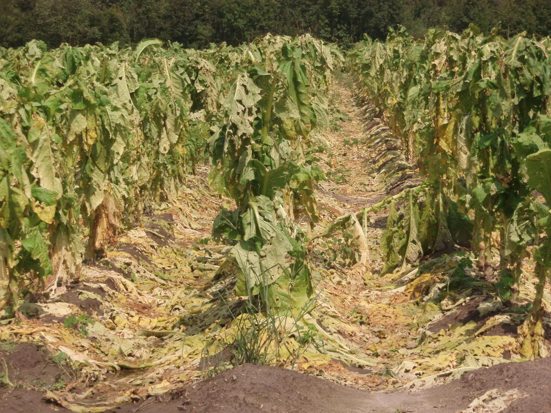
Crop Hail
General Information

Slide 26
Crop Hail
All tobacco acreage can be insured
NBG
Pays spot losses
Lower deductible than MPCI
0%-10%
Pays replant payment
Only way you can insure up to ACV
Combination of MPCI & CH
Optional wind coverage available

Slide 27
Crop Hail
Coverage available for other crops
Small grains
Coarse grains
ACS available
Continues coverage
Write early
Coverage effective at 12:01 a.m. the second day after signature is obtained

Slide 28
Tobacco
Year | Flue Cured Loss Ratio Totals (National)
2015 | 1.63
2014 | 1.05
2013 | 1.66
2012 | 1.05
2011 | 4.54
2010 | 2.25
2009 | 2.00
2008 | 2.46
2007 | 2.38
2006 | 3.55
2005 | 2.67

Slide 29
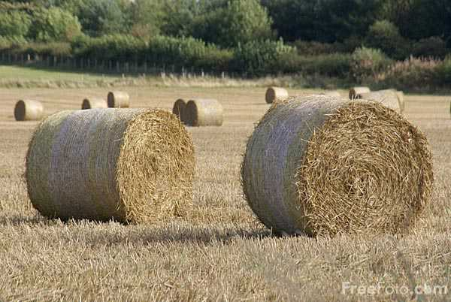
Pasture, Rangeland and Forage (PRF)
Payout as of 12/31/15
$883,231,344.

Slide 30
Livestock Risk Protection (LRP)
Payout For 2015
$9,837,675

Slide 31
Assignment of Indemnity
If you are filing an assignment of indemnity, please have your lender contact us for the most current form. This will save you and your lender time.
W-9s
If your policy is written in the name of a business you must have a completed W-9 on file. This is due to IRS reporting requirements, and the form will have to be completed prior to any claims being paid.

Slide 32
Short Notes
2015 Price elections
For VA |  | 2015 Prices
Flue | $ 1.80 | $ 1.80
Burley | $ 1.80 | $ 1.80
Dark | $ 2.15 | $ 2.00
Fresh Mkt. Tomatoes | $ 7.25 | $ 7.25
Corn | TBD | $ 4.15
Soybean | TBD | $ 9.78
Grain Sorghum | TBD | $ 3.99
Data mining used to determine anomalies
Trigger GSI’s

Slide 33
Key Points
Review

Slide 34
Key Points to Remember
Sales Closing
Deadline for Making Changes, Adding Crops or Counties
Spring Crops
February 28 for North Carolina and South Carolina
March 15 for Virginia, Tennessee, Kentucky and West Virginia
Fall Crops - September 30
PRF - November 15
Report entity changes when they occur
Example: Change in Marital status
Reconstituted Farms Must Be Reported to Us Within 45 Days of Sales Closing.
Map Book will be mailed prior to Spring planting
Retain and use for Fall plantings
Replants
An adjuster MUST contact you BEFORE you begin replanting.

Slide 35
Key Points to Remember (cont’d)
Acreage Reporting
Be accurate
Be Timely
Report to FSA FIRST
Obtain copy of 578PP
Forward to us
Identify ALL uninsurable acres
NBG (New Breaking Ground)
Practice uninsurable
Ex. wheat for fallow or hay, soybeans for hay
Crops planted after late plant date
Insurable IF planted late due to insurable cause of loss
60% of timely planted guarantee
Can elect to not insure
All Documents Must Be the Same
Policy
FSA
Sales Receipts/Settlement Sheets

Slide 36
Key Points to Remember (cont’d)
Provide timely notice of loss
Within 72 hours of occurrence.
Report each occurrence of a loss.
Quality losses on grain
Mycotoxins
Notify us immediately.
Settlement sheets for all production MUST be supplied to adjuster before final claim can be completed.
Carry over production (old crop) MUST be measured by an adjuster before new crop is added to bins where old crop is stored.
Should the current crop be used for a purpose other than originally intended, such as soybeans for hay rather than for grain, an adjuster must be involved prior to harvest.
Corn that is insured as grain but will be harvested as silage, must be appraised, even if you don’t anticipate a loss.

Slide 37
Key Points to Remember (cont’d)
Production Reporting
Report as soon as all sales are completed.
All production (insured and uninsured) MUST be reported.
Obtain settlement sheets on all crops and retain.
Review Your Schedule of Insurance
Notify Us Immediately of Any Errors.
Know Your Premium Due Date.
Know Your Policy Provisions.
Your Contract Is Continuous Unless You Cancel It In Writing Before Sales Closing.
Be Timely and Accurate.
Contact Us Anytime You Have Questions.

Slide 38
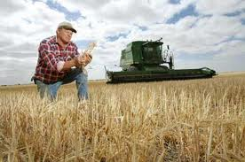
What Does J.T. Davis Insurance Agency Offer?
49 years personal experience
6 office personnel to serve you with combined experience of 117 years
Devoted 100% to crop insurance
Individual risk management planning
Experienced, competent adjusting staff
Fast claim turn around
Direct deposit
E-Business access
Toll free 800 service
Represents the #1 insurance provider
RCIS
Subsidiary of Wells Fargo and Company
AM best rating “A”
Visit us on the web at: www.jtdavisins.com
or Like Us on Facebook
JT Davis Insurance Agency, Inc. is an Equal Opportunity Provider

Slide 39
Questions

Slide 40
J. T. Davis Insurance Agency, Inc.
1101 Indian Jim Trail
Nathalie, Virginia 24577
1-800-248-5480
www.jtdavisins.com
Notes:
This slide is for handout only.

